Slide 1
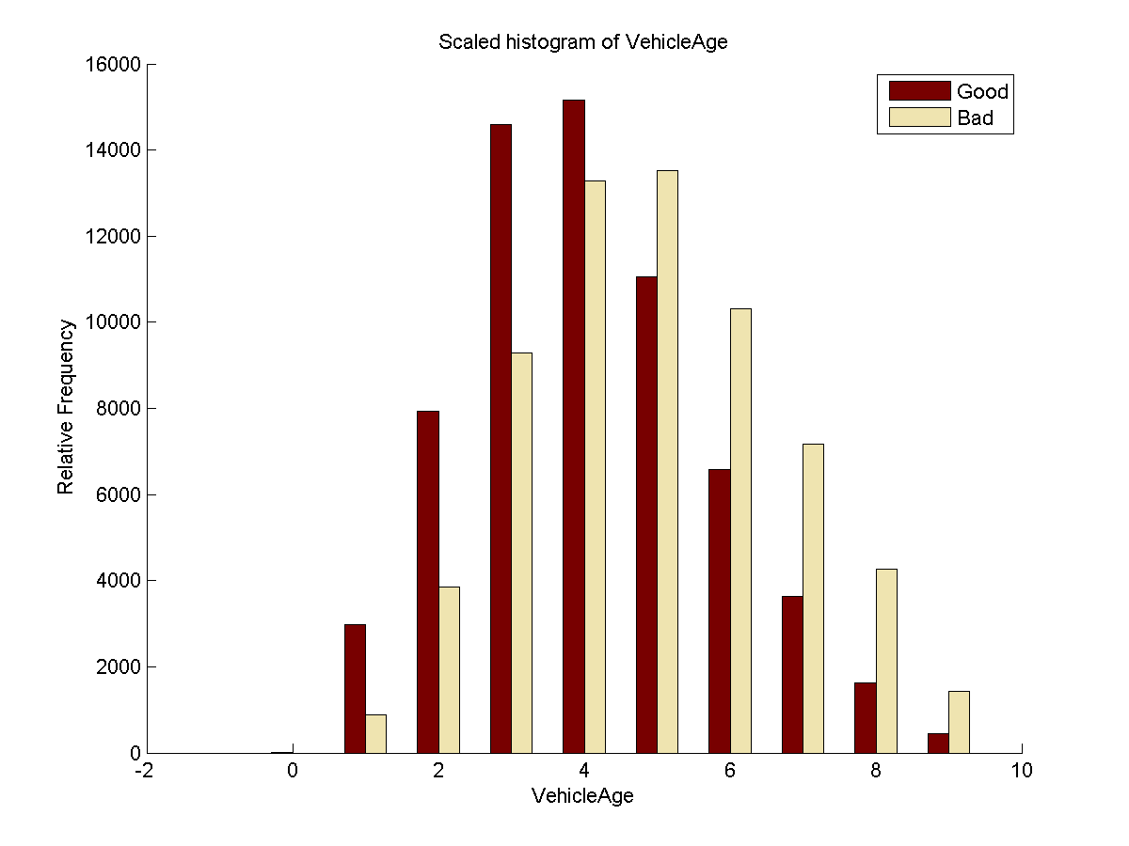
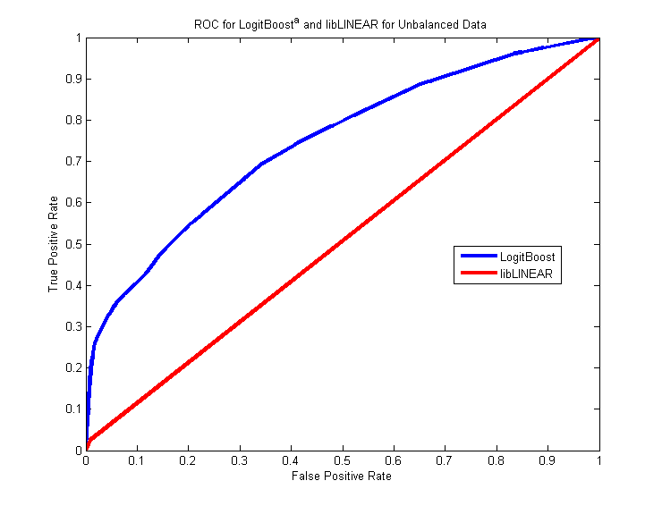
Don’t Get Kicked – Machine Learning Predictions for Car Buying
Albert Ho, Robert Romano, Xin Alice Wu – Department of Mechanical Engineering, Stanford University – CS229: Machine Learning
Introduction
Algorithm Selection
Discussion
When you go to an auto dealership with the intent to buy a used car, you want a good selection to choose from. Auto dealerships purchase their used cars through auto auctions and they want the same things: to buy as many cars as they can in the best condition possible. Our task was to use machine learning to help auto dealerships avoid bad car purchases, called “kicked cars”, at auto auctions.
MATLAB
Our initial attempts to analyze the data occurred primarily in MATLAB. Because the data was categorized into two labels, good or bad car purchases, we used logistic regression and libLINEAR¹ v.1.92. Initial attempts at classification went poorly due to heavy overlap between our good and bad training sets. We decided to follow a different approach based on the concept of boosting, which combines various weak classifiers to create a strong classifier³.
Weka
To use boosting algorithms, we used the software package called Weka² v. 3.7.7. Using Weka, we could apply libLINEAR and naïve bayes along with a slew of boosting algorithms such as adaBoostM1, logitBoost, and ensemble selection.
Performance Metric
Initially, we evaluated the success of our algorithms based on correctly classified instances(%), but soon realized that even the null hypothesis could achieve 87.7%. We then switched our metrics to AUC, a generally accepted metric for classification performance, and F1, which accounts for the tradeoff between precision/recall. FN and FP may be more important metrics in application because has a direct impact on profit and loss for a car dealership, as illustrated below:
Final Result
Based on metrics of AUC and F1, LogitBoost did the best for both balanced and unbalanced data sets.
Data Preprocessing/Visualization
Data Characteristics
All of our data was obtained from the Kaggle.com challenge “Don’t Get Kicked” hosted by CARVANA. It could be described as follows:
Preprocessing
The steps we took to preprocess our data changed throughout the project as follows:
Visualization
Total Profit = TN*Gross Profit + FN*Loss
Opportunity Cost = FP*Gross Profit
Contained 32 features and 73041 samples
Contained binary, nominal, and numeric data
Good cars were heavily overrepresented, constituting 87.7% of our entire data set
Data was highly inseparable/overlapping
Performance Evaluation
Algorithms | Performance on Unbalanced Training Set |  |  | Performance on Balanced Training Set
 | Correctly Classified Instances (%) | AUC | F1 Score | Correctly Classified Instances (%) | AUC | F1 Score
naÏve Bayes | 89.41 | 0.746 | 0.351 | 66.46 | 0.745 | 0.332
libLinear | 87.33 | 0.509 | 0.050 | 25.72 | 0.548 | 0.236
logistic | 82.84 | 0.708 | 0.350 | 83.81 | 0.713 | 0.347
logitBoostª | 89.41 | 0.746 | 0.351 | 66.46 | 0.745 | 0.332
logitBoost^{b} | 89.55 | 0.757 | 0.364 | 73.37 | 0.759 | 0.365
logitBoost^{c} | 90.11 | 0.758 | 0.368 | 84.45 | 0.686 | 0.338
adaBoostM1ª | 89.51 | 0.724 | 0.370 | 63.21 | 0.719 | 0.316
ensemble^{e} | 90.12 | 0.691 | 0.359 | 81.47 | 0.650 | 0.327
ensemble^{d,e} | 89.88 | 0.730 | 0.358 | 83.75 | 0.694 | 0.350
Future Work
1) Evaluate models on separated data
2) Run RUSBoost, which improves classification performance when training data is skewed
3) Purchase server farms on which to run Weka
Converting nominal data to numeric and filling in missing data fields
Normalizing numeric data from 0 to 1
Balancing the data
Acknowledgement
We would like to thank Professor Andrew Ng and the TAs all their help on this project, Kaggle and CARVANA for providing the data set.
a. Decision Stump, b. Decision Stump 100 Iterations, c. Decision Table, d. J48 Decision Tree, e. Maximize for ROC
References
[1] R.-E. Fan, et al. LIBLINEAR: A Library for Large Linear Classification, Journal of Machine Learning Research 9(2008), 1871-1874. Software available at http://www.csie.ntu.edu.tw/~cjlin/liblinear
[2] Mark Hall, et al. (2009); The WEKA Data Mining Software: An Update; SIGKDD Explorations, Volume 11, Issue 1.
[3] Friedman, Jerome, et al."Additive logistic regression: a statistical view of boosting”. The annals of statistics 28.2 (2000): 337-407.

